Slide 1
Label-Flip Poisoning Attack on Malware Detection
Meenakshi S L
2025EMCY10024
Paper: http://arxiv.org/pdf/2301.01044
Dataset: https://www.kaggle.com/competitions/malware-detection/data

Slide 2
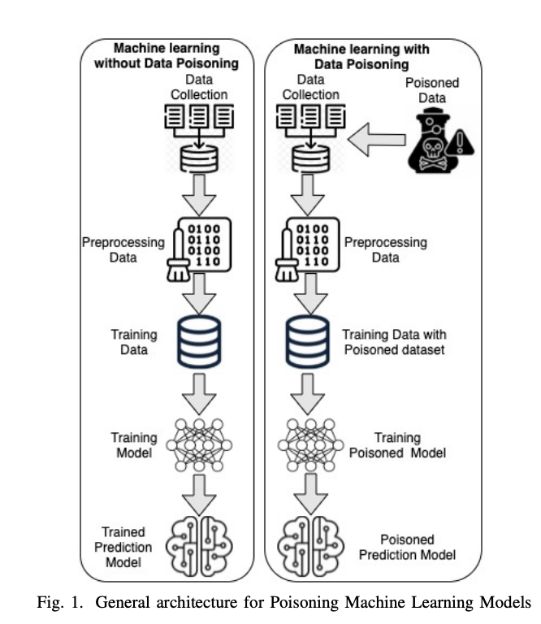
Introduction
Why ML for malware detection:
  Scale: billions of samples → manual triage infeasible
  Generalization: beyond signatures and static rules
  Adaptivity: retrain as threats evolve
  ML has proven to solve the zero-day malware detection
which is unresolved by traditional signature-based approaches.
Feature sources:
  Static (PE headers, imports, byte/strings)
  Dynamic (behavior/API traces, network I/O)
  Hybrid/metadata (reputation, sandbox outcomes)
Models in practice/research:
  Linear/logistic, SVMs
  Trees/ensembles (Random Forest, boosting)
  k‑NN, MLPs, deeper architectures

Slide 3
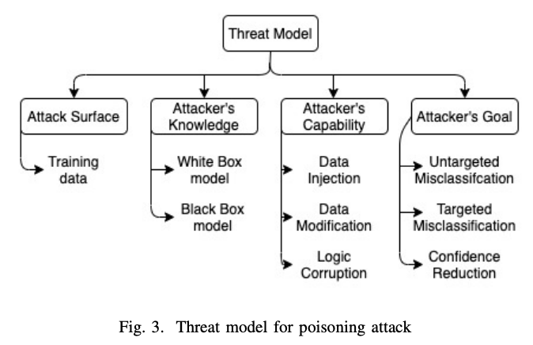
Problem Definition
Objective : Perform a comparative analysis of different machine learning-based malware detectors’ robustness against label-flipping data poisoning attack
Threat Model: flip y for a fraction of training samples (10–20%); clean test set
Why this Paper:
  Realistic: weak/automated labeling pipelines introduce noise
  Comparative: 8 classic models → family‑specific brittleness
  Provide threat modeling for adversarial poisoning attacks against malware detectors
Focuses on performance on models against data poisoning attacks

Slide 4
Methodology (paper)
Dataset: VT/VirusShare‑style binary labels (paper’s corpus)
Models (8):LogisticRegression, KNN, Linear SVM, Decision Tree, Perceptron, MLP, SGD, RandomForest,
Protocol:
  Stratified train/test: identical split for clean vs. poisoned
  Poisoning: random label flips at 10% and 20% of training labels
  Metrics: Accuracy, Precision, Recall; confusion analyses

Slide 5
Methodology (my implementation)
Data: ML-case-study/Kaggle-data.csv (label: legitimate)
Split: stratified 80/20, seed=42; sample ≈10k rows for runtime
Models: same 8
Repo: https://github.com/meenakshisl/ML-case-study
Command:
python ML-case-study/run_experiments.py \
--input-csv ML-case-study/Kaggle-data.csv \
--label-col legitimate \
--sample-size 10000 \
--test-size 0.2 \
--flip-fracs 0.0 0.1 0.2 0.3 0.4 \
--seed 42 \
--output-dir ML-case-study/outputs

Slide 6
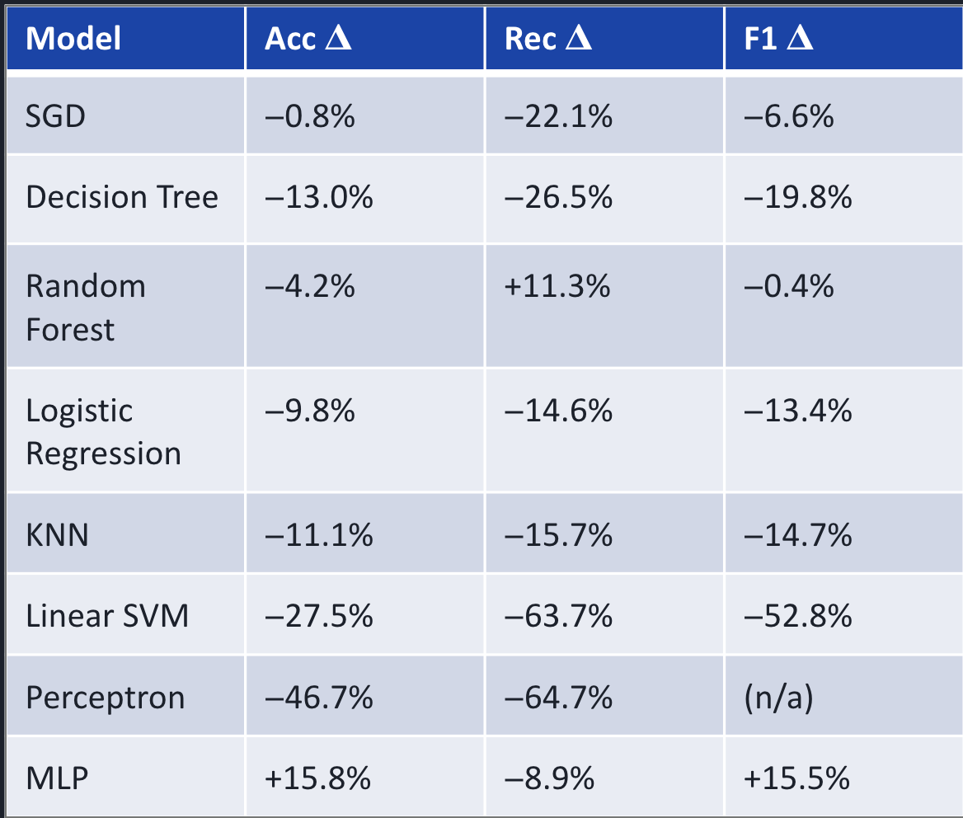
Results (paper)
Trends supported by paper visuals:
  Recall suffers most → more false negatives (missed malware)
  Linear/SVM degrade sharply
  Trees are more resilient at low flip
  Patterns persist across settings/seeds

Slide 7
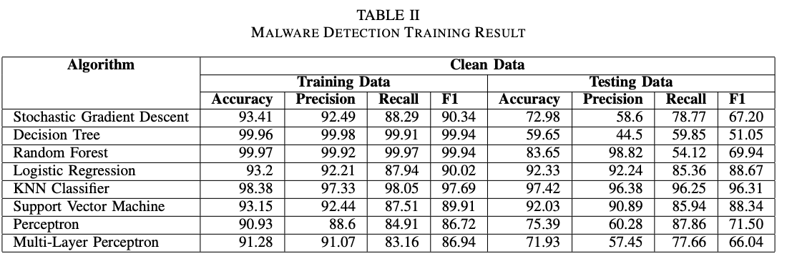
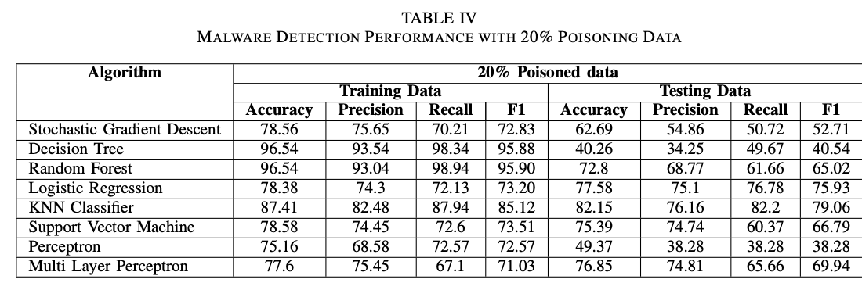
Results (paper)

Slide 8
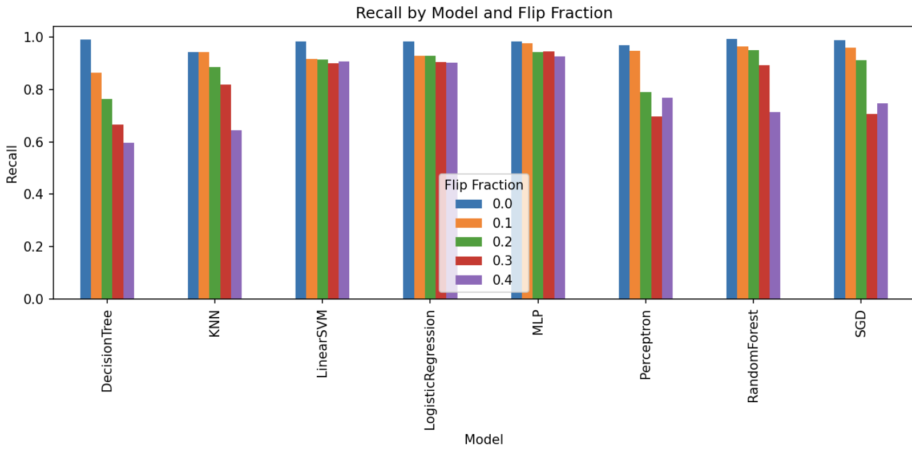
Results (local)
Alignment: recall drops; linear models brittle; RF relatively robust
Local vs Paper: dataset/feature domain, sample size/runtime, preprocessing/regularization, single split/seed
Notes:
results maybe different due to the small amount of dataset used

Slide 9
Conclusion
Label‑flip poisoning degrades malware detectors
  impact varies by model family
  Linear/SVM degrade most
  Trees are relatively resilient at lower flip
  MLP mixed
Takeaway: label integrity and data‑quality gates are essential in production pipelines

Slide 10
Future Work (defenses)
Data provenance & trusted labeling — Datasheets for Datasets (Gebru et al.)
Label sanitization / outlier detection — Confident Learning / Cleanlab (Northcutt et al.)
Influence‑based auditing — Influence Functions (Koh & Liang)
Robust learning objectives — Generalized Cross‑Entropy (Zhang & Sabuncu)
Adversarial / poison‑aware training — Certified Defenses for Data Poisoning (Steinhardt et al.)
Ensemble & cross‑validation across sources — Co‑Teaching (Han et al.)
Continuous monitoring & rollback — Hidden Technical Debt in ML (Sculley et al.)

